Slide 1
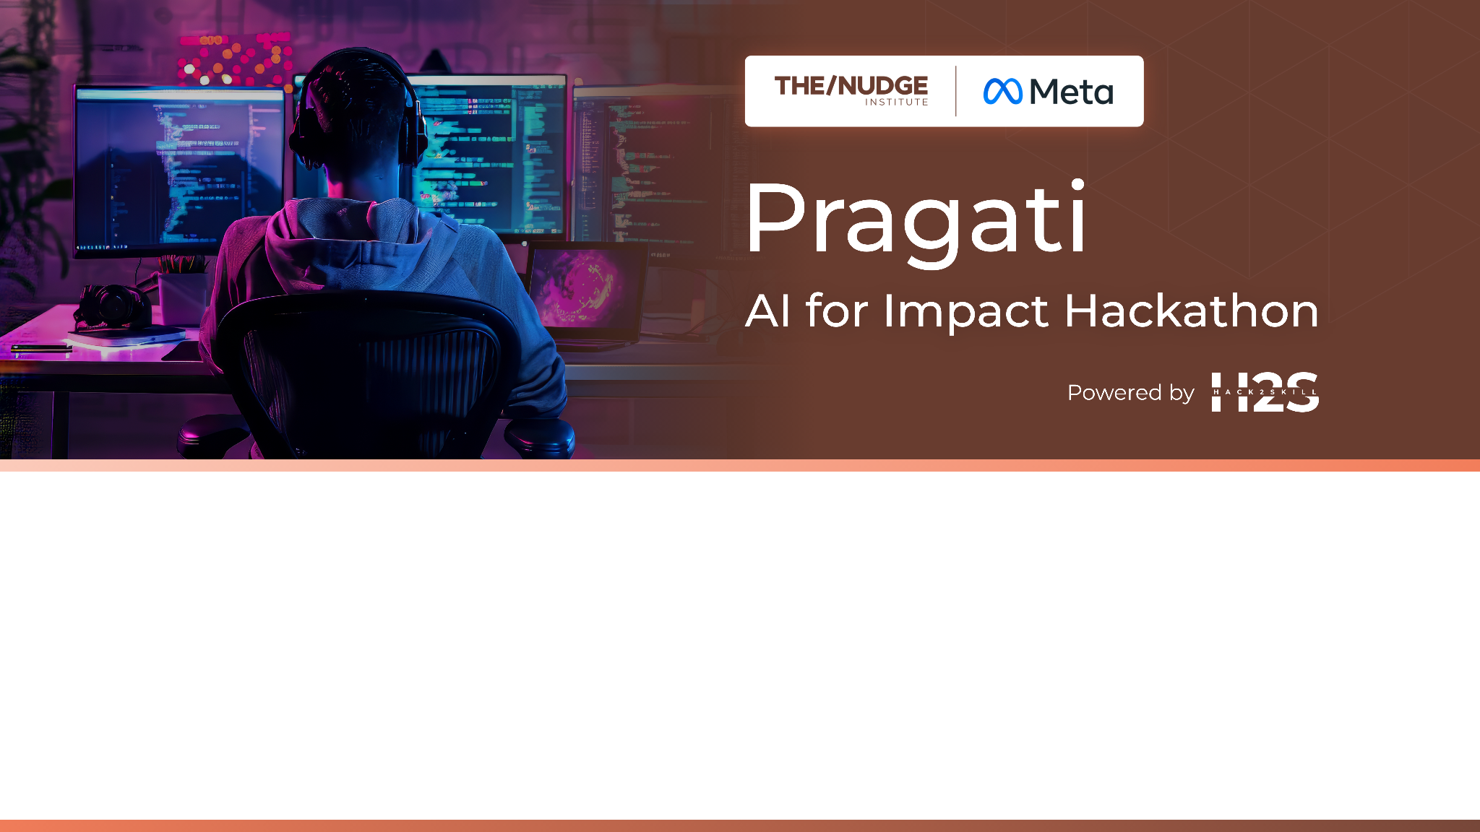
Team Name : Traffic_free
Team Leader Name : Darimisetty Nithish Kumar
Which domain does your idea address? (Agriculture / Healthcare / Skilling / Education): Healthcare

Slide 2

What is the problem you are solving?
Current traffic and navigation systems ignore real-time congestion, causing delays in emergencies. Our AI-powered traffic signals and enhanced navigation adapt to live traffic patterns, reducing response times and helping ambulances and healthcare workers reach hospitals faster—potentially saving lives.

Slide 3
Describe your solution. How different is it from any of the other existing ideas? How will it be able to solve the problem? USP of the proposed solution? What is the intended impact of your solution.
Our solution combines AI-driven smart traffic signals and an enhanced Google Maps navigation system to address real-time traffic congestion, with a strong focus on healthcare accessibility and emergency response. Traditional traffic signals operate on fixed timers, regardless of vehicle presence, while navigation apps often prioritize the shortest route without considering live congestion. This leads to inefficient traffic flow and delays, especially critical for ambulances and healthcare personnel.
We propose a two-part system:
Smart Traffic Signals powered by AI and IoT: Using real-time video feeds and road-embedded sensors, the system adjusts signal timings based on current traffic density. If one lane is empty while another is congested, the green signal shifts accordingly, reducing idle wait times and improving flow.
Intelligent Route Optimization in Google Maps: By analyzing traffic data from the last 10 minutes, the system highlights not just the shortest, but the least congested route in green. This ensures smoother travel during peak hours or emergencies.
What makes our solution unique is its dual-layer approach, combining adaptive traffic control and intelligent navigation, unlike existing systems that only focus on one. Our solution analyzes real-time traffic behavior instead of relying on static data.
The USP lies in its healthcare-aware design. In emergencies, the system prioritizes ambulance routing by dynamically adjusting signals and selecting the fastest routes to hospitals, reducing response times and potentially saving lives.
The intended impact is a smarter urban traffic ecosystem that minimizes congestion, shortens commutes, and strengthens infrastructure for emergency medical services. Scalable across cities, this solution can significantly enhance traffic management and healthcare logistics.

Slide 4
Who is the primary user of your solution, and explain how your solution will leverage open-source AI to address the aspects mentioned in the Key Design Guidelines.
The primary users of our solution are urban traffic authorities, municipal planners, and emergency healthcare services such as ambulance networks. Indirect beneficiaries include commuters, patients, and medical staff who rely on timely, traffic-free routes.
Our solution uses open-source AI frameworks like TensorFlow, PyTorch, and OpenCV to process real-time video feeds and sensor data for traffic density detection and prediction. These AI models dynamically adjust traffic signals and integrate with navigation systems to suggest the least congested routes, especially prioritizing emergency vehicles.
Aligned with the Key Design Guidelines:
It is impact-driven, directly improving emergency response times and healthcare accessibility.
Scalable and replicable, as it uses open-source tools and modular architecture adaptable to cities of various sizes.
Sustainable, by reducing idle time at signals, cutting fuel use and emissions.
Open and customizable, allowing local governments and developers to refine models based on specific infrastructure or policies.
By leveraging community-supported AI models, we ensure transparency, affordability, and faster innovation cycles. This approach not only modernizes traffic management but also strengthens healthcare support through smarter, AI-enhanced urban mobility systems.

Slide 5
How is this solution scalable?
Our solution is highly scalable due to its modular architecture and reliance on open-source AI frameworks. The smart traffic signal system can be deployed in phases across intersections, while the navigation enhancement integrates seamlessly with existing platforms like Google Maps. Real-time data processing is handled via edge devices and cloud support, allowing easy expansion to new areas. Additionally, the use of standard IoT hardware and customizable AI models ensures adaptability to different city sizes, traffic patterns, and infrastructure levels—making it suitable for both urban and semi-urban environments.

Slide 6
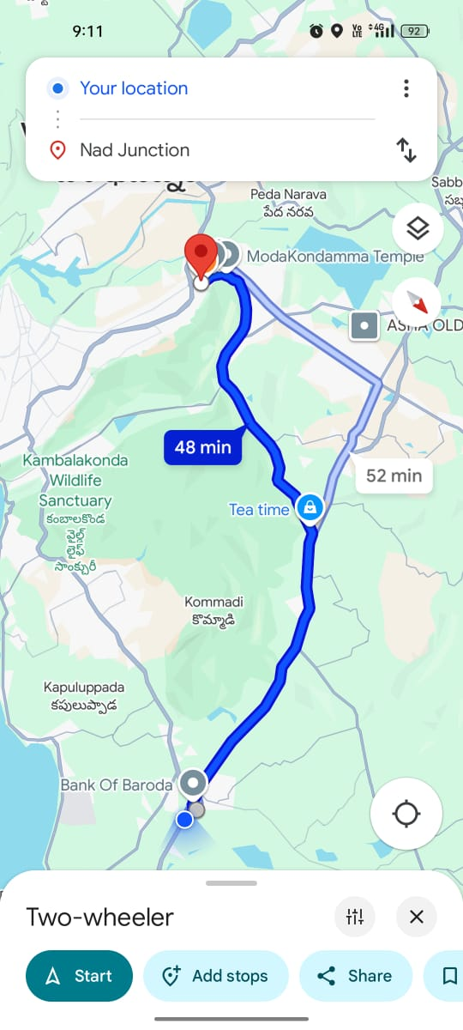
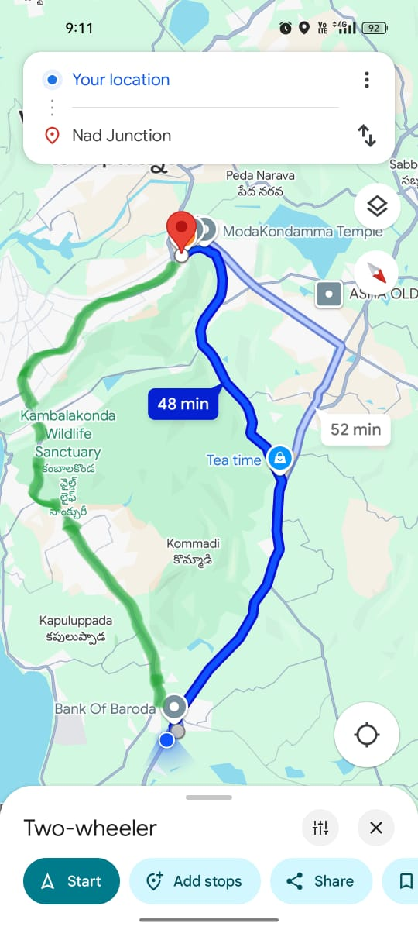
List of features offered by the solution
AI-Powered Smart Traffic Signals
Dynamic signal timing based on real-time traffic density.
Prioritization for emergency vehicles like ambulances.
Reduced idle wait time and improved traffic flow.
IoT Sensor Integration
Real-time traffic monitoring using road-embedded sensors and cameras.
Data collection for continuous learning and system optimization.
Enhanced Google Maps Navigation
Traffic pattern analysis from the last 10 minutes.
Route suggestions based on least congestion, not just shortest distance.
Green-highlighted optimal paths.
Healthcare-Aware Design
Priority routing for ambulances.
Faster access to hospitals during emergencies.
Scalability & Modularity
Easy integration with existing infrastructure.
Compatible with cities of varying sizes and traffic systems.
Open-Source AI Framework
Uses TensorFlow, PyTorch, or OpenCV for transparency and adaptability.
Actual GMap
Suggested Gmap

Slide 7
What open-source AI tools and technologies will you use to design the solution?
TensorFlow
For building and training deep learning models for traffic density prediction and signal control logic.
PyTorch
Alternative to TensorFlow for real-time traffic behavior modeling and emergency routing logic.
OpenCV
For computer vision tasks like vehicle detection, lane analysis, and congestion estimation using camera feeds.
YOLO (You Only Look Once)
A real-time object detection algorithm to identify vehicles from video frames quickly and efficiently.
Apache Kafka / MQTT
For real-time data streaming from IoT sensors and edge devices.
Node-RED
A low-code tool for wiring together IoT devices, APIs, and services, useful for prototyping and deployment.
Scikit-learn
For basic machine learning models, traffic pattern prediction, and data analysis.
Pandas & NumPy
For handling and processing large volumes of traffic and sensor data.
Google Maps API (with Python integration)
For customizing route logic and overlaying congestion data on maps.
Kubernetes & Docker
For containerized deployment and scaling of AI models across multiple locations.

Slide 8
Why are these open-source technologies the most appropriate for your solution?
These open-source technologies are ideal for our solution due to their flexibility, scalability, and community support. TensorFlow and PyTorch provide robust deep learning capabilities essential for real-time traffic prediction and emergency prioritization. OpenCV and YOLO enable efficient vehicle detection from video feeds, critical for dynamic signal control. Scikit-learn, NumPy, and Pandas support data analysis and traffic pattern modeling. MQTT and Node-RED simplify IoT sensor integration and data flow, while Docker and Kubernetes ensure scalable, portable deployments across cities. Google Maps API allows seamless route optimization integration. These tools are not only cost-effective but also continuously improved by global developer communities, making them reliable and easy to adapt. Their open nature allows customization to suit local infrastructure, enabling faster adoption in both urban and semi-urban environments. This combination ensures a powerful, scalable, and healthcare-supportive traffic management system.

Slide 9
Describe the Solutions Architecture
Our solution architecture integrates AI, IoT, and cloud technologies to create a dynamic, responsive traffic management system focused on real-time congestion control and healthcare emergency response. At the core, traffic cameras and embedded road sensors collect live data on vehicle density, speed, and lane status. These inputs are processed by edge devices like Raspberry Pi or Jetson Nano, using lightweight AI models (YOLO + OpenCV) to detect and count vehicles, and TensorFlow/PyTorch models to analyze congestion patterns. This processed data feeds into a central Decision Engine that determines signal behavior. If a lane is empty while another is congested, the signal dynamically switches green to optimize flow. Additionally, the system can detect emergency vehicles such as ambulances using specialized recognition models and instantly prioritize their path by overriding signal patterns and alerting nearby intersections. Simultaneously, the route optimization module integrates with Google Maps API, analyzing the last 10 minutes of live traffic data to suggest the least congested route in green, rather than just the shortest path. Real-time communication between edge devices, cloud services, and signals is facilitated through lightweight protocols like MQTT or Apache Kafka, and automation workflows are built using Node-RED. Data is stored in MongoDB or InfluxDB for historical analysis and future predictions. The entire infrastructure is deployed using Docker containers and orchestrated via Kubernetes, ensuring the system is modular, scalable, and easily replicable in other cities. For monitoring and control, a dashboard allows traffic authorities to view real-time congestion status, control signals manually if needed, and assess performance metrics like wait times and emergency response efficiency. Ambulance drivers or healthcare personnel can access a mobile interface that provides real-time, optimized routes to hospitals with dynamic updates. The healthcare integration is designed to reduce delays in emergency medical transport, potentially saving lives by cutting travel time through both signal prioritization and intelligent navigation. By combining smart traffic signal control, real-time navigation, and emergency vehicle awareness into one cohesive, open-source-driven platform, this architecture provides an effective, city-scale solution to modern traffic challenges while directly supporting critical healthcare infrastructure.

Slide 10
Provide a high-level architecture diagram or a use-case diagram of your proposed solution
+---------------------------+
| User Interface |
|---------------------------|
| Dashboards / Mobile |
| Apps |
+---------------------------+
|
V
+---------------------------+
| Integration Layer |
|---------------------------|
| Google Maps API |
+---------------------------+
|
V
+---------------------------+
| Processing Layer |
|---------------------------|
| Decision Engine |
| Data Storage (MongoDB / |
| InfluxDB) |
+---------------------------+
|
V
+---------------------------+
| Communication Layer |
|---------------------------|
| MQTT / Apache Kafka |
+---------------------------+
|
V
+---------------------------+
| Device Layer (Edge) |
|---------------------------|
| Traffic Cameras & Road |
| Sensors & Edge |
| Devices (Raspberry Pi, |
| Jetson Nano) |
| +--------------+
| | Data Flow |
+------------| (Real-Time) |
+--------------+

Slide 11
Please share the wireframes/Mock diagrams of the proposed solution
Actual GMap
Suggested Gmap

Slide 12
What datasets will your solution use? Are they publicly available, synthetic, or user-generated?
Our solution will use a combination of publicly available, synthetic, and user-generated datasets. For vehicle detection and traffic density analysis, we will use public datasets like the UA-DETRAC, CityFlow, and KITTI datasets, which include annotated traffic surveillance videos for AI training. Synthetic datasets will be generated using traffic simulation tools like SUMO (Simulation of Urban MObility) to model traffic flow under various conditions, including emergency vehicle scenarios. Additionally, user-generated data from IoT sensors, edge devices, and smart cameras deployed at intersections will be collected in real time to train, fine-tune, and validate the system. Historical and live traffic data from Google Maps APIs will also support route optimization. Combining all three types ensures a robust, real-world-ready system capable of dynamic, city-scale deployment.

Slide 13
Does your solution require cloud-based computation, or can it work with on-device processing? If cloud-based, how do you plan to address connectivity challenges and cost constraints?
Our solution uses a hybrid architecture combining on-device edge processing and cloud-based computation. Critical tasks like vehicle detection, emergency vehicle recognition, and initial traffic density analysis are handled on-device using lightweight AI models on Raspberry Pi or Jetson Nano, ensuring low latency and continuous operation even during network disruptions. The cloud is used for more intensive tasks like historical trend analysis, route optimization, large-scale data storage, and remote monitoring via dashboards.
To address connectivity challenges, the system is designed to fall back to edge-only operation when the cloud is temporarily unavailable, ensuring uninterrupted traffic signal control. For cost constraints, we use open-source tools, containerization (Docker), and scalable cloud platforms with pay-as-you-go models, minimizing infrastructure overhead. This balanced approach offers resilience, scalability, and cost-effectiveness while ensuring real-time responsiveness in traffic management and healthcare emergency routing.

Slide 14


